Slide 1
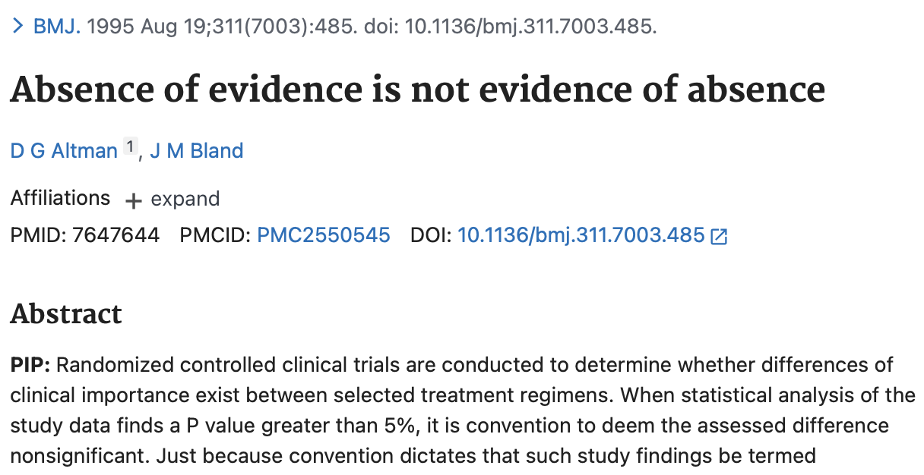
Partner A: Explain what the article title means (in general)
Partner B: Give an example to illustrate. Doesn’t need to be medical. (What is something you believe but don’t have empirical evidence that would convince a skeptic to change their mind?)

Slide 2
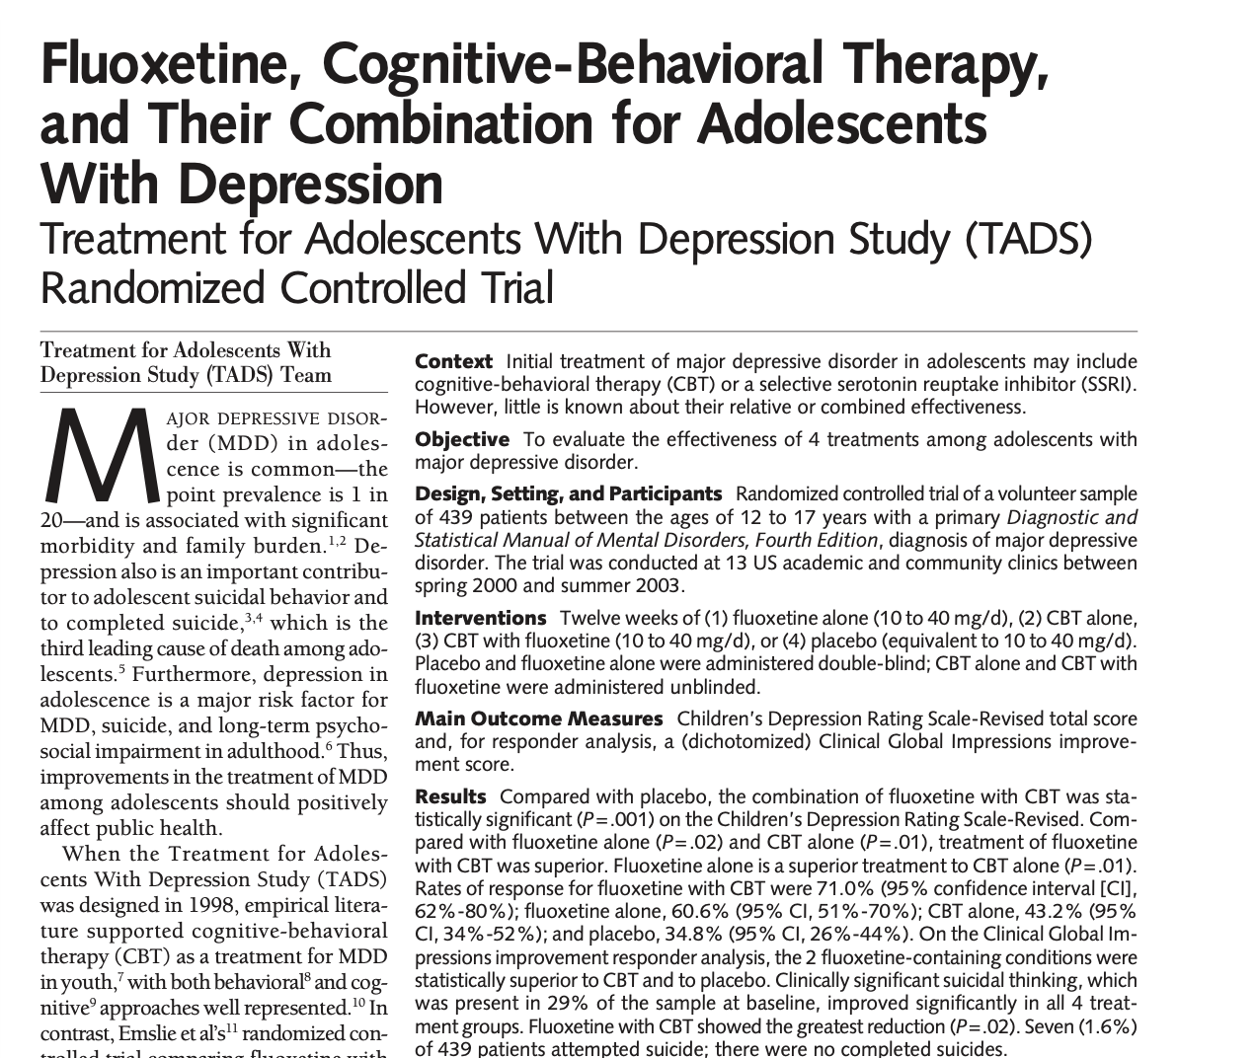
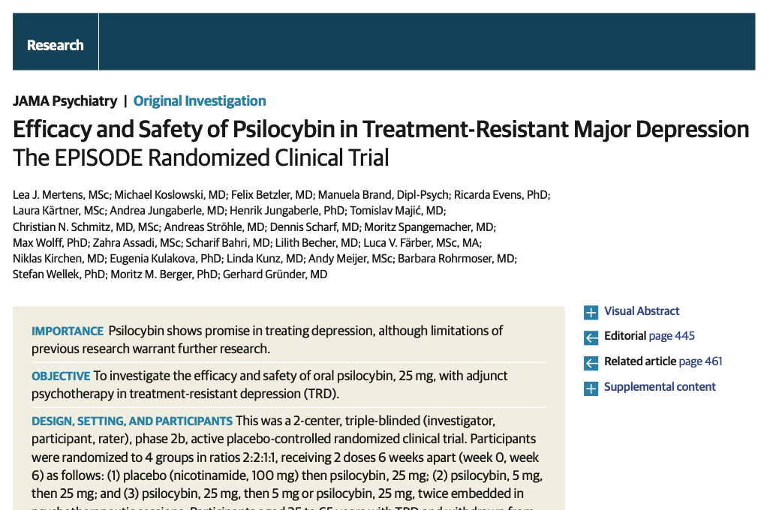
Reading 301
Steve White

Slide 3

Outline
Is this study informative? (today)
How big is the effect? (August)
Other topics and applications (September)
“I ask all the questions”
- Marguerite Perrin

Slide 4
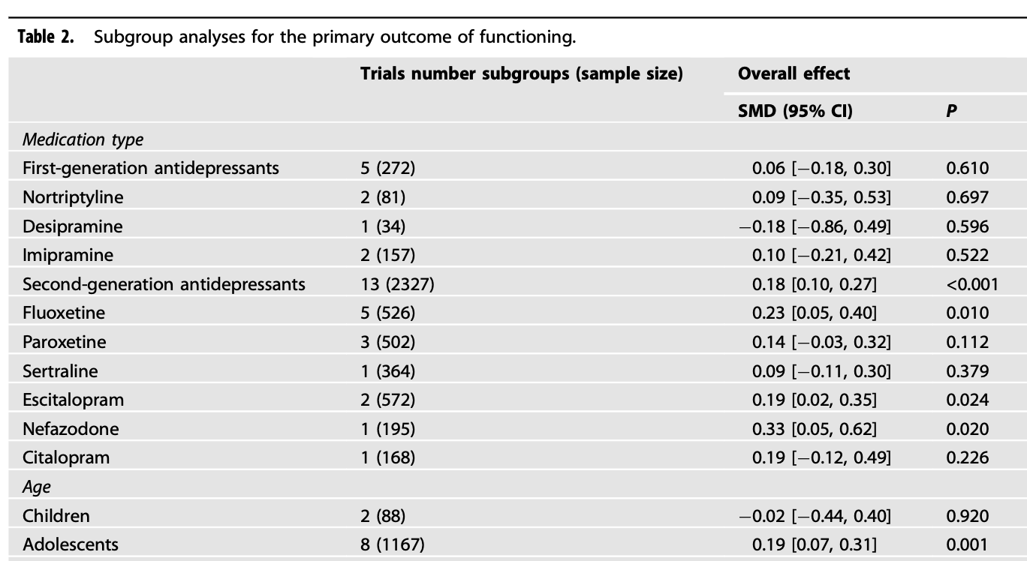
Evaluate these claims:
These data show that second-generation antidepressants work better than first-generation antidepressants.
The drugs improve functioning for adolescents but not for children.
doi:10.1038/s41398-022-01951-9

Slide 5
Statistical significance
The means are are statistically significantly different if the p-value < ______ [arbitrary cutoff, classically 5%]
key idea: statistical significance means that you observations are improbable if the null is true (e.g. that treatment and control outcomes are the same)

Slide 6
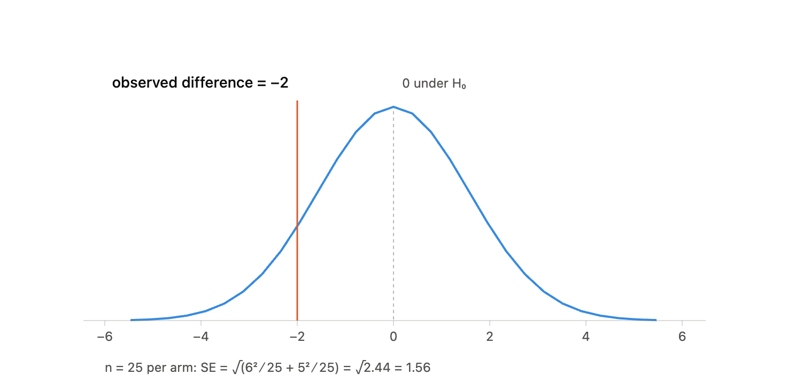
don’t reject the null (p > 0.05)

Slide 7
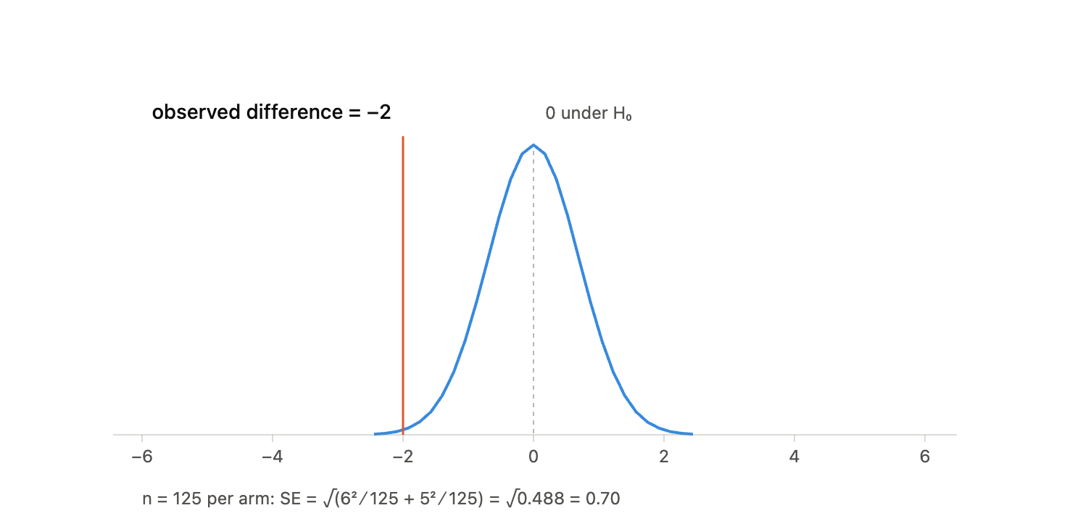
reject null hypothesis (p < 0.05)

Slide 8
Confidence intervals
Our process so far:
(1) start with hypothesized difference of 0
(2) ask if data reject it (at p = 0.05 threshold)
alternative: build a list of differences that the data don’t reject (at p = 0.05)
website to illustrate
Notes:
0 isn’t in CI = reject null, tautological

Slide 9
Returning to these examples:
These data show that second-generation antidepressants work better than first-generation antidepressants.
The drugs improve functioning for adolescents but not for children.
doi:10.1038/s41398-022-01951-9

Slide 10
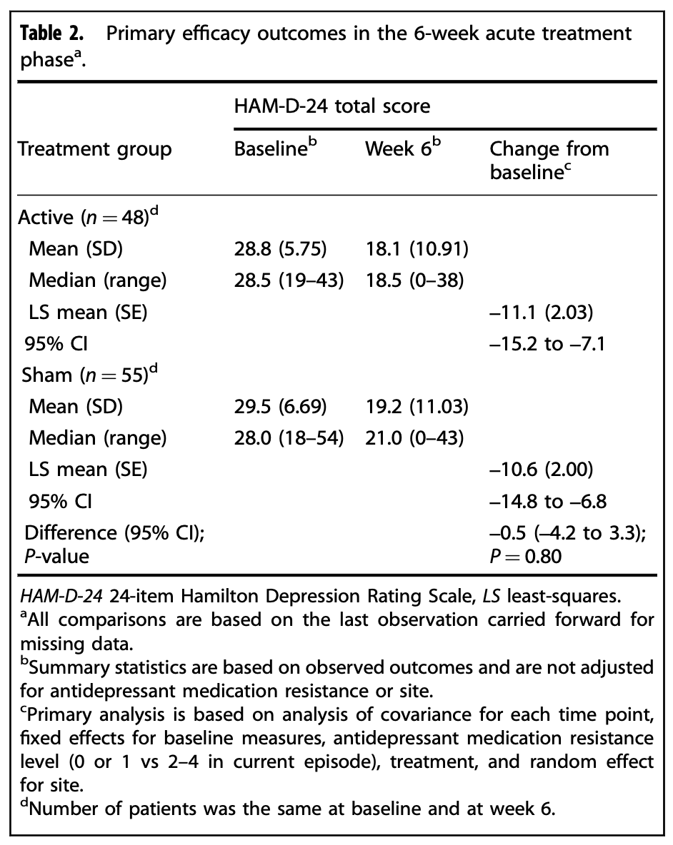
Discussion:
Evaluate this claim: “this study showed that TMS is not effective as a treatment in this population”
Croarkin et al. (the TMS in adolescents we love so much)

Slide 11
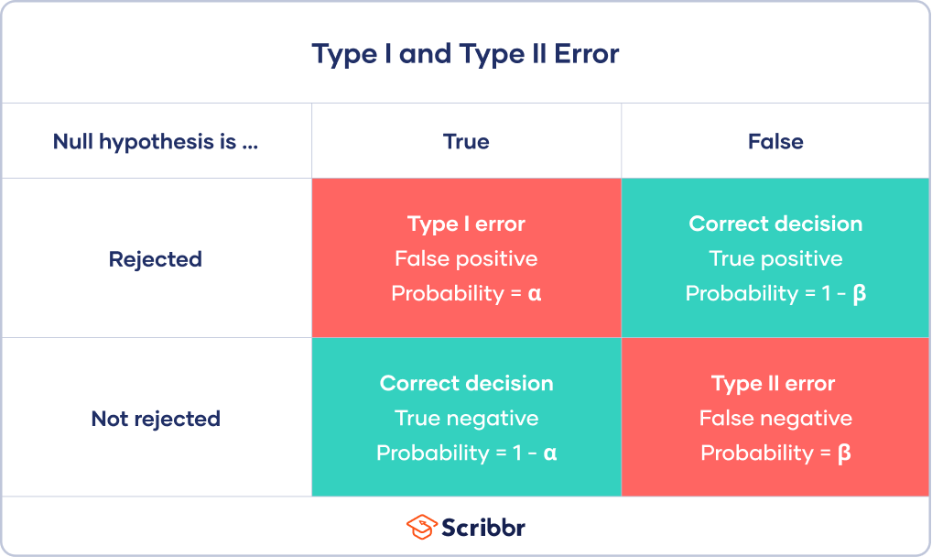
errors in hypothesis testing
These are the exact same errors you get with any study/test.
FALSE POSITIVE
FALSE NEGATIVE

Slide 12
Power
= prob. of detecting some hypothesized effect
(think of this like sensitivity)
Practice: You read a new RCT with all the characteristics of a good study (blinding, attrition low, etc.). It found no statistically significant effect on the primary outcome.
If . . . | High Power (90%) study | Low Power (30%) study
your conclusion about whether this treatment works
“doesn’t work”
(if it did we’d have very likely seen evidence of that in the trial)
“absence of evidence isn’t evidence of absence”

Slide 13
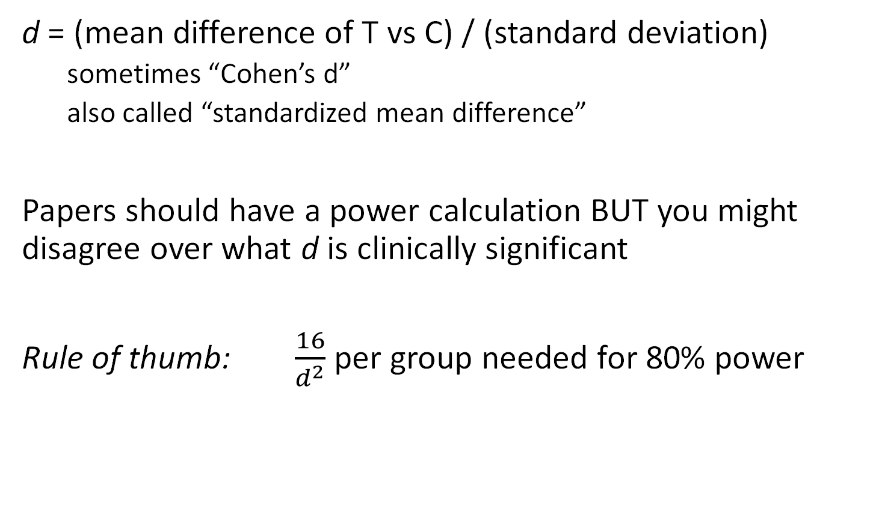
effect size
d = (mean difference of T vs C) / (standard deviation)
sometimes “Cohen’s d”
also called “standardized mean difference”
Papers should have a power calculation BUT you might disagree over what d is clinically significant
Rule of thumb: $\frac{16}{d^{2}}$ per group needed for 80% power

Slide 14
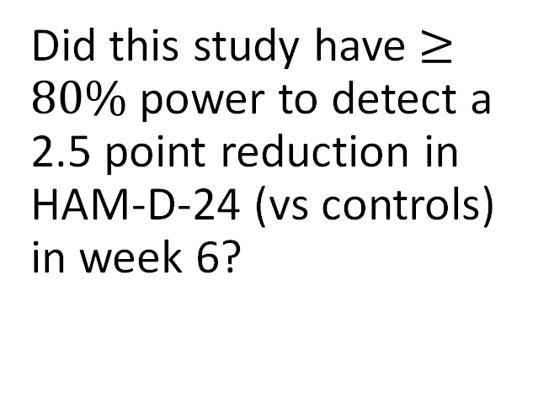
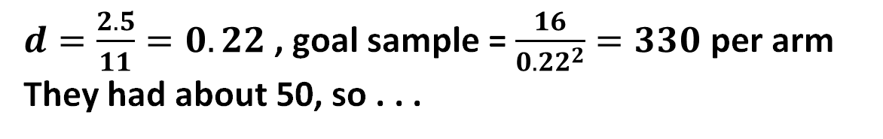
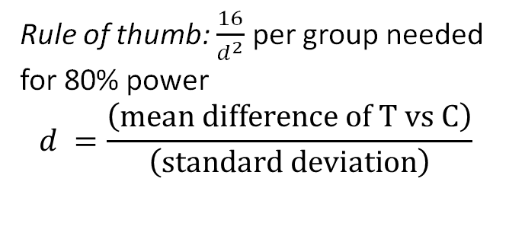
Rule of thumb: $\frac{16}{d^{2}}$ per group needed for 80% power
$$d =\frac{\left(mean difference of T vs C\right)}{\left(standard deviation\right)}$$
Did this study have $≥80\%$ power to detect a 2.5 point reduction in HAM-D-24 (vs controls) in week 6?
$d=\frac{2.5}{11}=0.22$ , goal sample = $\frac{16}{{0.22}^{2}}=330$ per arm
They had about 50, so . . .
Croarkin et al. (the TMS in adolescents we love so much)

Slide 15
d and clinical significance
Cohen’s d | Cohen’s label (1988) | common description
0.2 | “small” | “minimal” / “not clinically meaningful”
0.5 | “medium” | “moderate” (NICE used this as threshold of clinically significant for a while, IIRC)
0.8 | “large” | “highly effective”
Examples:
“Stimulants remain the most effective treatment for ADHD, with effect sizes between 0.8 and 1.0—some of the highest in medicine”
– Elizabeth Steuber, Harvard & Carlat
“antidepressants have an effect size [0.27 – 0.4] (vs placebo) that is comparable to other standard treatments in medicine”
– Awais Aftab, The Case for Antidepressants

Slide 16

It’s a trap!
treatment | Cohen’s d
ASA for 2º MI prevention | 0.12
PPIs for heart burn | 0.8
Which is more significant?
preventing 70 days of heartburn a year
OR
reducing your risk of death by 2.4pp
Stimulants
. . . on ratings scales | ~0.9
. . . on learning (test scores) | ~0.1
Sources: doi:10.1016/S0140-6736(88)92833-4 and doi:10.1002/14651858.CD002095.pub5

Slide 17
Classic study of Paroxetine in children/adolescents
Outcome | Paroxetine | Placebo | p
HAM-D total, change from baseline | 18.98 → 8.24 | 18.97 → 9.88 | .13
Response (HAM-D ≤ 8 or ≥ 50% drop) | 66.7% | 55.2% | .11
K-SADS-L 9-item dep. subscore | 28.25 → 16.59 | 28.84 → 19.27 | .07
Mean CGI score | 2.37 | 2.73 | .09
HAM-D ≤ 8 (“remission”) | 63.3% | 46.0% | .02
Original study had four additional outcomes, all negative, not shown to save space.
Should I conclude “this study showed paroxetine increased remission?”
multiple comparisons – huge risk of false positives

Slide 18
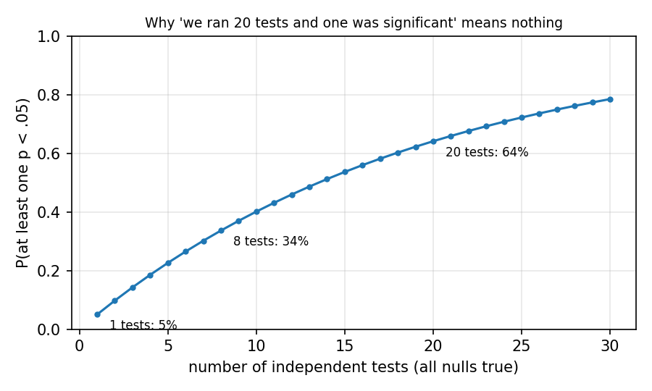
Seek and Ye Shall Find

Slide 19
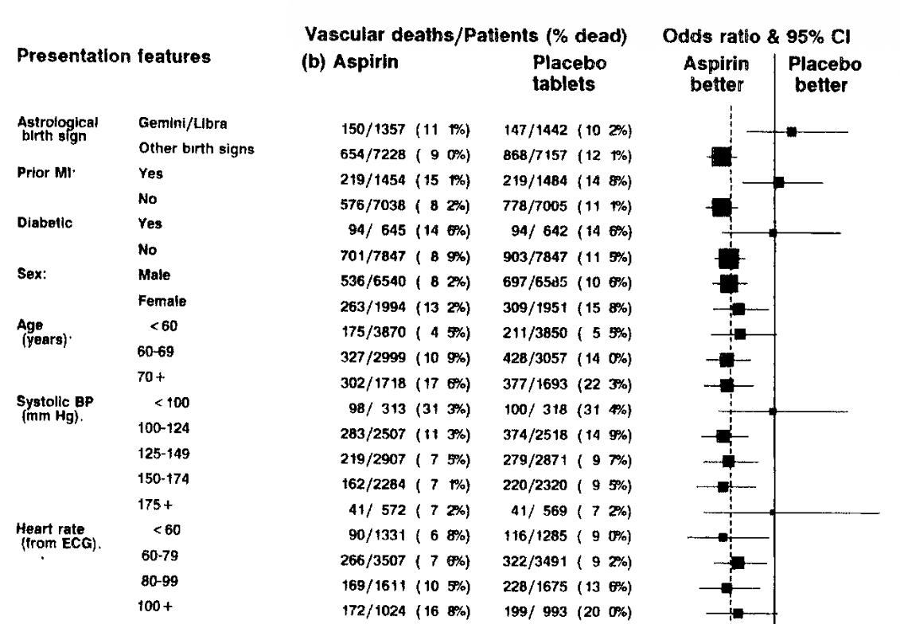
Subgroup analysis
Subgroup analysis is the classic way for a paper to end up with many comparisons
doi:10.1016/S0140-6736(88)92833-4

Slide 20
P-hacking
the bad version of multiple comparisons
probably was common until recently
Classic study of Paroxetine in children/adolescents
Outcome | Paroxetine | Placebo | p
HAM-D total, change from baseline | 18.98 → 8.24 | 18.97 → 9.88 | .13
Response (HAM-D ≤ 8 or ≥ 50% drop) | 66.7% | 55.2% | .11
K-SADS-L 9-item dep. subscore | 28.25 → 16.59 | 28.84 → 19.27 | .07
Mean CGI score | 2.37 | 2.73 | .09
Autonomous Functioning Checklists: | — | — | n.s.
Self-Perception Profile | — | — | n.s.
Sickness Impact Profile | — | — | n.s.
HAM-D ≤ 8 (“remission”) | 63.3% | 46.0% | .02
HAM-D depressed-mood item (0–4) | 2.99 → 0.99 | 2.86 → 1.53 | .001
K-SADS-L depressed-mood item | 4.57 → 2.37 | 4.63 → 2.90 | .05
CGI 1 or 2 (much improved) | 65.6% | 48.3% | .02

Slide 21
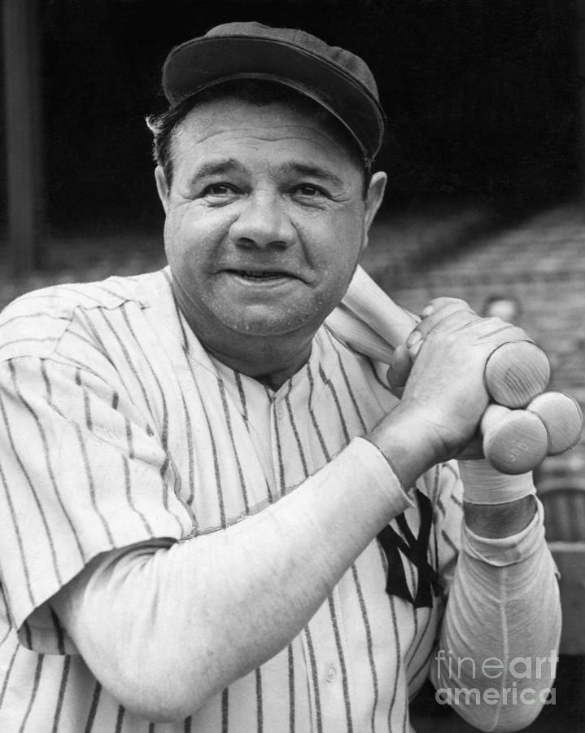
Pre-specification
= write down measures, analysis methods BEFORE you see the data
primary outcome (one, maybe two), time point
post it where you can't quietly edit it: ClinicalTrials.gov or a published protocol
Still an issue! COMPare checked 67 trials in the 5 top medical journals; 58 had switched, added, or dropped outcomes vs. their registration
“Call your shot.”
Le Noury et al. BMJ 2015;351:h4320 (Restoring Study 329). Goldacre et al. Trials 2019;20:118 (COMPare).

Slide 22
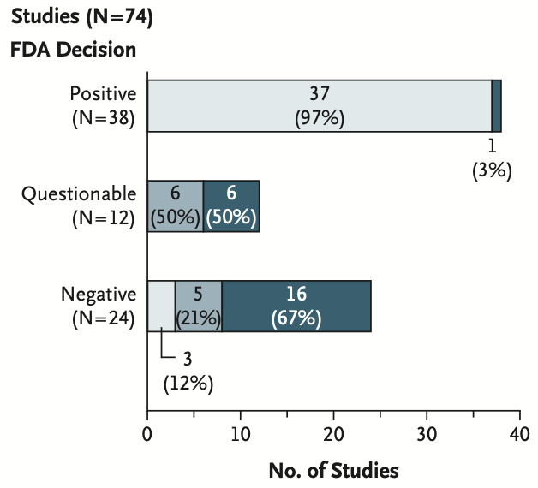
Publication bias
by law all trials of drugs are sent to the FDA
authors can submit results for publication or not
Erick Turner worked at the FDA (now OHSU) and noticed a pattern
DOI: 10.1056/NEJMsa065779

Slide 23
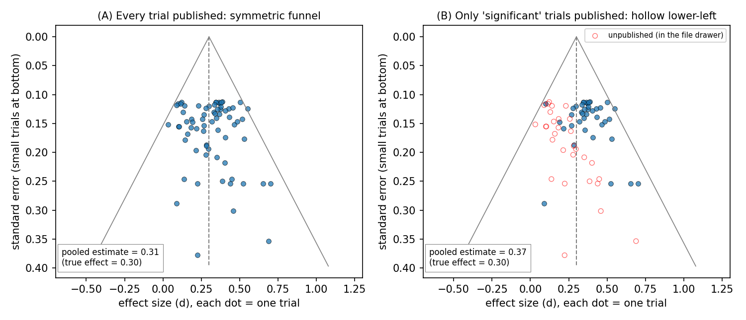
Funnel plots
deferred for time

Slide 24

If we got data and plotted it, what would the “best fit” pattern look like?
dim.marginal utilty
linear
mom
$$\sqrt{evil}$$
income

Slide 25
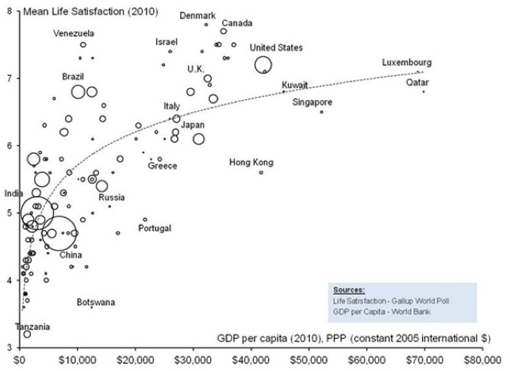
if you’re curious (country level)

Slide 26
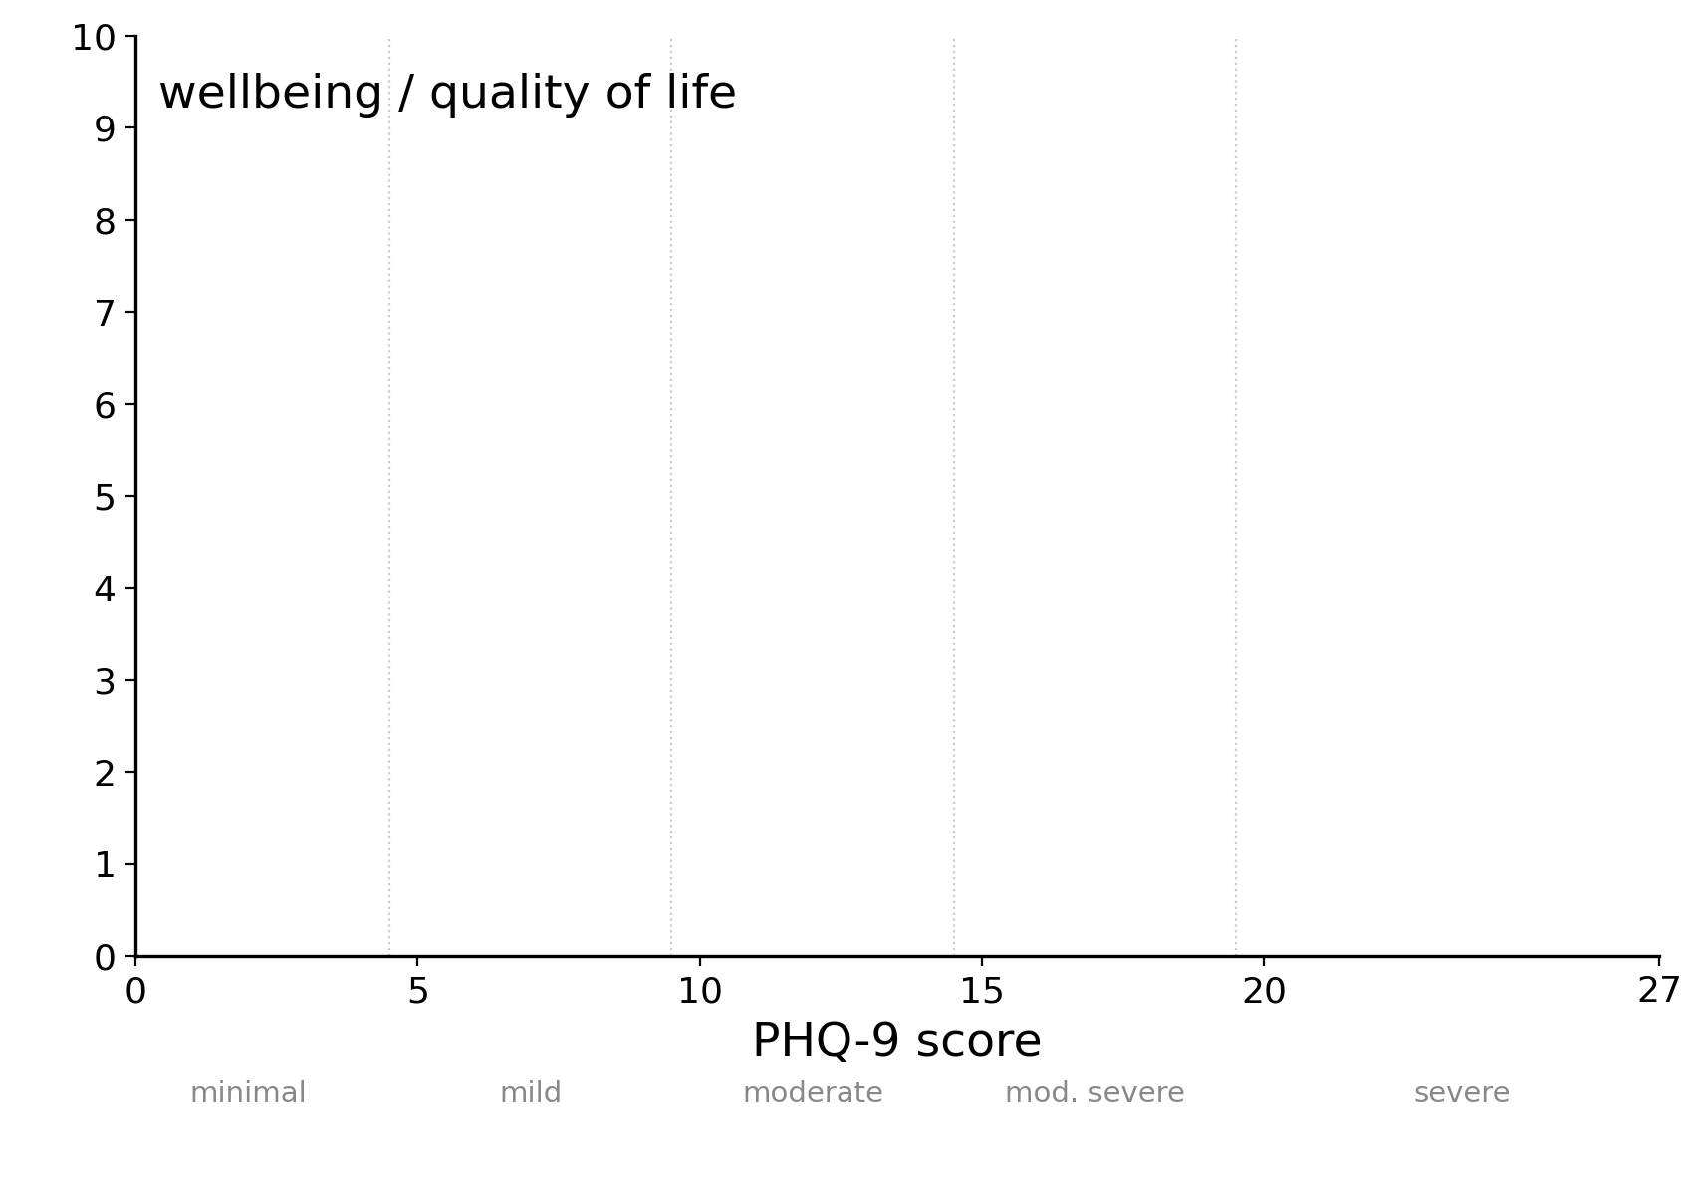
What about?

Slide 27
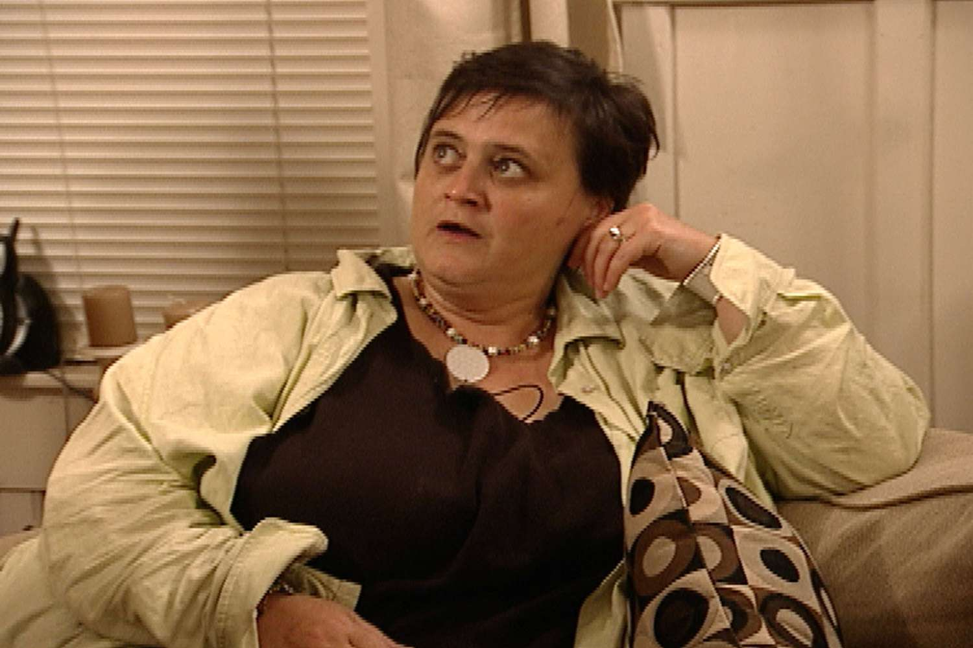
Summary
confidence interval = every difference the data don't reject
power = the chance a study this size catches an effect that's really there. Small null trial → “absence of evidence isn't evidence of absence”
effect size (d) = difference in SD units. Fine for power calculations. Not a measure of clinical significance.
Multiple comparisons – if you run many comparisons you’ll get “significant” one(s) chance.
Publication bias: the trials you never read are probably negative
you, asking all the questions

Slide 28
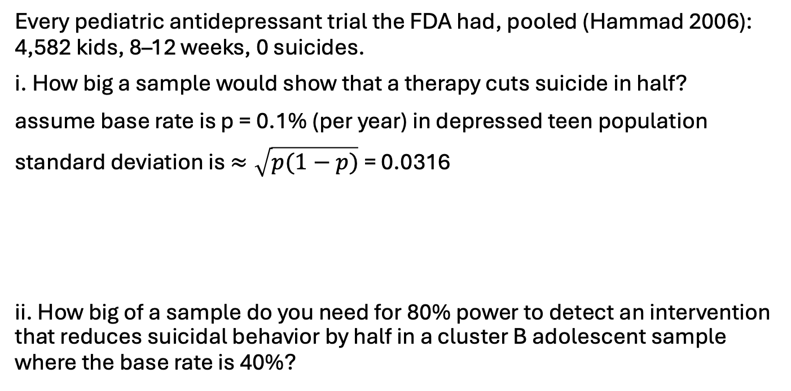
power practice (if time)
Every pediatric antidepressant trial the FDA had, pooled (Hammad 2006): 4,582 kids, 8–12 weeks, 0 suicides.
i. How big a sample would show that a therapy cuts suicide in half?
assume base rate is p = 0.1% (per year) in depressed teen population
standard deviation is $≈\sqrt{p(1−p)}$ = 0.0316
ii. How big of a sample do you need for 80% power to detect an intervention that reduces suicidal behavior by half in a cluster B adolescent sample where the base rate is 40%?
Sources: Hammad et al. Arch Gen Psychiatry 2006; Emslie et al. JAACAP 2006 (TADS); Brent et al. Am J Psychiatry 2009 (TORDIA); McCauley et al. JAMA Psychiatry 2018; Meltzer et al. Arch Gen Psychiatry 2003 (InterSePT); CDC WONDER 2022.

Slide 29
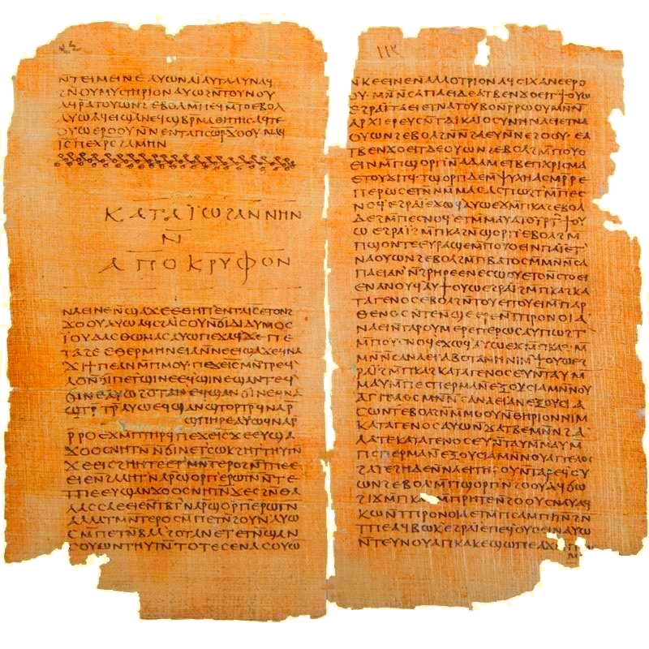
“[Psychiatry] is like a man who wanted to kill a powerful man. He drew the sword in his house and drove it into the wall, that he might know his hand would be strong. Then he slew the powerful man.”
– Gospel of Thomas #98, Blatz translation

